Slide 1



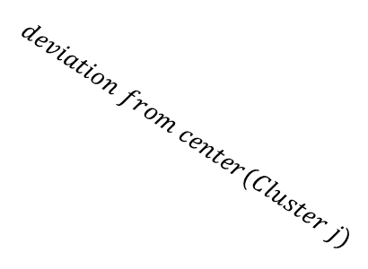


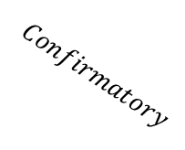
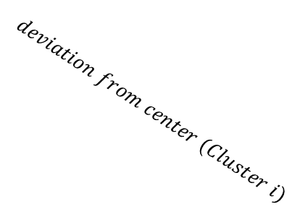
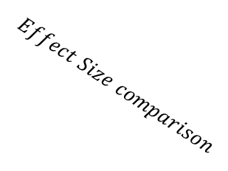


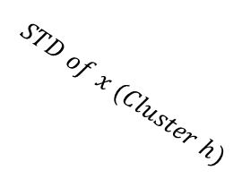

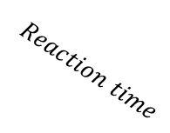
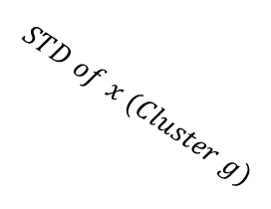


$$Effect Size comparison$$
$$Reach$$
$$Keyboard$$
$$Exploratory$$
$$Confirmatory$$
$$AUC$$
$$Reaction time$$
$$Movement time$$
$$Num of COM$$
$$Total traveled distance$$
$$MAD$$
$$Reach area$$
$$RT$$
$$deviation from center (Cluster i)$$
$$deviation from center(Cluster j)$$
$$STD of x (Cluster g)$$
$$STD of x (Cluster h)$$
Permutation + Clustering
Deviation
from center
i
j
Proportion of Z traveled

